Slide 1
Faster Sorting Methods
Chapter 9
Data Structures and Abstractions with Java, 4e
Frank Carrano
© 2015 Pearson Education, Inc., Upper Saddle River, NJ. All rights reserved.

Slide 2
Merge Sort
Divides an array into halves
Sorts the two halves,
  Then merges them into one sorted array.
The algorithm for merge sort is usually stated recursively.
Major programming effort is in the merge process
© 2015 Pearson Education, Inc., Upper Saddle River, NJ. All rights reserved.

Slide 3
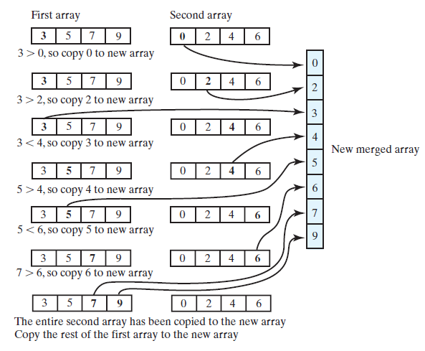
Merging Arrays
FIGURE 9-1 Merging two sorted arrays into one sorted array
© 2015 Pearson Education, Inc., Upper Saddle River, NJ. All rights reserved.

Slide 4
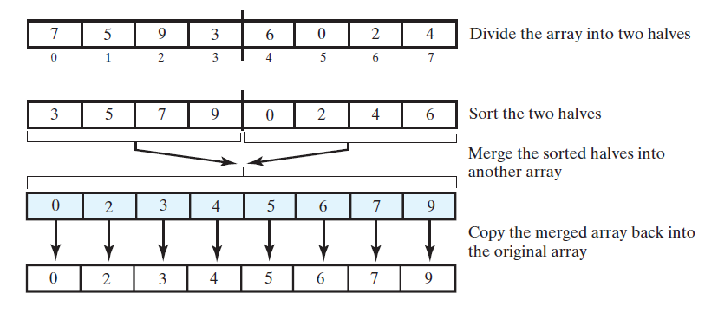
Recursive Merge Sort
FIGURE 9-2 The major steps in a merge sort
© 2015 Pearson Education, Inc., Upper Saddle River, NJ. All rights reserved.

Slide 5
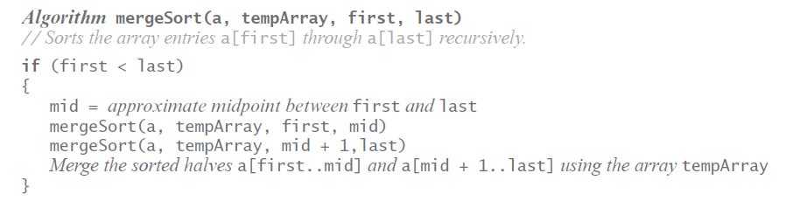
Recursive Merge Sort
Recursive algorithm for merge sort.
© 2015 Pearson Education, Inc., Upper Saddle River, NJ. All rights reserved.

Slide 6
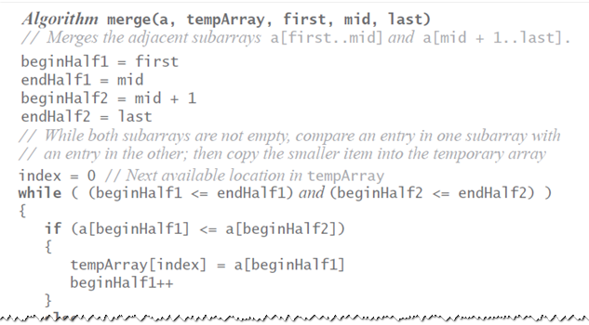
Recursive Merge Sort
Pseudocode which describes the merge step.
© 2015 Pearson Education, Inc., Upper Saddle River, NJ. All rights reserved.

Slide 7
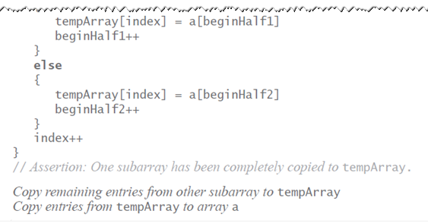
Recursive Merge Sort
Pseudocode which describes the merge step.
© 2015 Pearson Education, Inc., Upper Saddle River, NJ. All rights reserved.

Slide 8
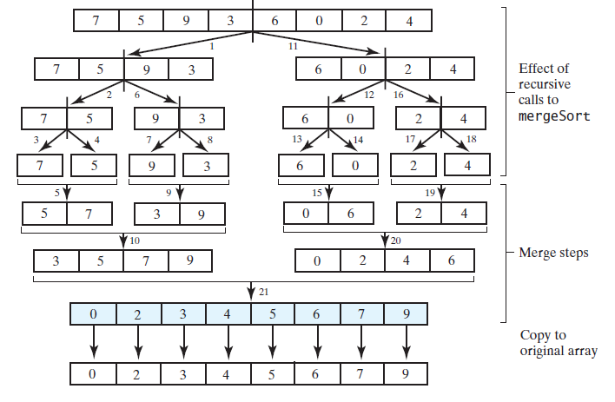
Recursive Merge Sort
FIGURE 9-3 The effect of the recursive calls
and the merges during a merge sort
© 2015 Pearson Education, Inc., Upper Saddle River, NJ. All rights reserved.

Slide 9
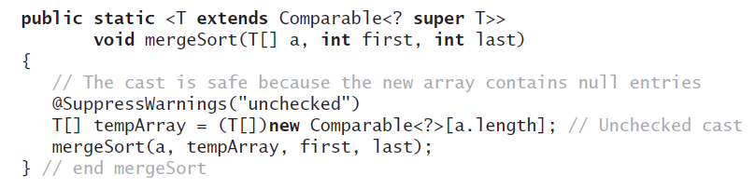
Recursive Merge Sort
Be careful to allocate the temporary array only once.
© 2015 Pearson Education, Inc., Upper Saddle River, NJ. All rights reserved.

Slide 10
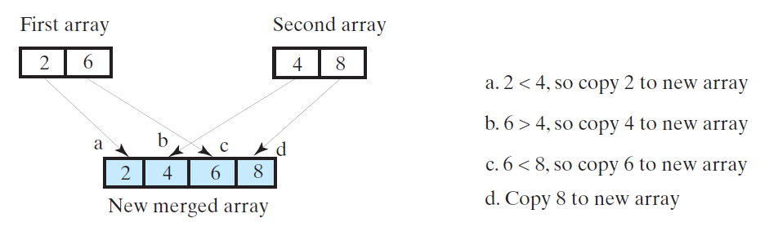
Efficiency of Merge Sort
FIGURE 9-4 A worst-case merge of two sorted arrays.
Efficiency is O(n log n).
© 2015 Pearson Education, Inc., Upper Saddle River, NJ. All rights reserved.

Slide 11
Iterative Merge Sort
Less simple than recursive version.
  Need to control the merges.
Will be more efficient of both time and space.
  But, trickier to code without error.
© 2015 Pearson Education, Inc., Upper Saddle River, NJ. All rights reserved.

Slide 12
Iterative Merge Sort
Starts at beginning of array
  Merges pairs of individual entries to form two-entry subarrays
Returns to the beginning of array and merges pairs of the two-entry subarrays to form four-entry subarrays
  And so on
After merging all pairs of subarrays of a particular length, might have entries left over.
© 2015 Pearson Education, Inc., Upper Saddle River, NJ. All rights reserved.

Slide 13
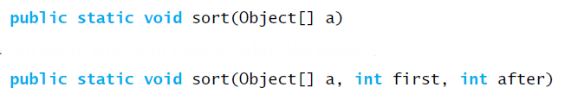
Merge Sort in the
Java Class Library
Class Arrays in the package java.util defines versions of a static method sort
© 2015 Pearson Education, Inc., Upper Saddle River, NJ. All rights reserved.

Slide 14
Quick Sort
Divides an array into two pieces
  Pieces are not necessarily halves of the array
  Chooses one entry in the array—called the pivot
Partitions the array
© 2015 Pearson Education, Inc., Upper Saddle River, NJ. All rights reserved.

Slide 15
Quick Sort
When pivot chosen, array rearranged such that:
  Pivot is in position that it will occupy in final sorted array
  Entries in positions before pivot are less than or equal to pivot
  Entries in positions after pivot are greater than or equal to pivot
© 2015 Pearson Education, Inc., Upper Saddle River, NJ. All rights reserved.

Slide 16
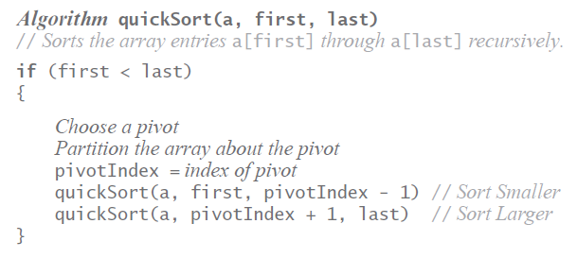
Quick Sort
Algorithm that describes our sorting strategy:
© 2015 Pearson Education, Inc., Upper Saddle River, NJ. All rights reserved.

Slide 17
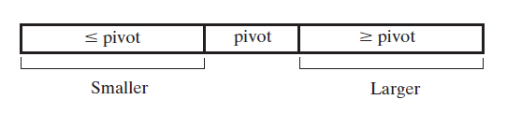
Quick Sort
FIGURE 9-5 A partition of an array during a quick sort
Quick sort is O(n log n) in average case,
O(n²) in worst case.
Choice of pivots affects behavior
© 2015 Pearson Education, Inc., Upper Saddle River, NJ. All rights reserved.

Slide 18
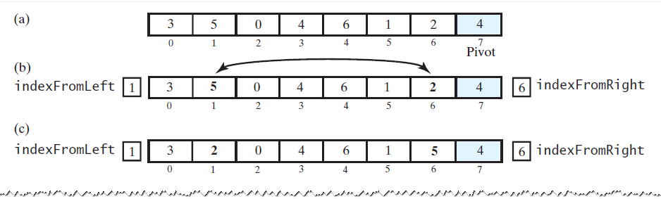
Creating the Partition
FIGURE 9-6 A partitioning strategy for quick sort
© 2015 Pearson Education, Inc., Upper Saddle River, NJ. All rights reserved.

Slide 19
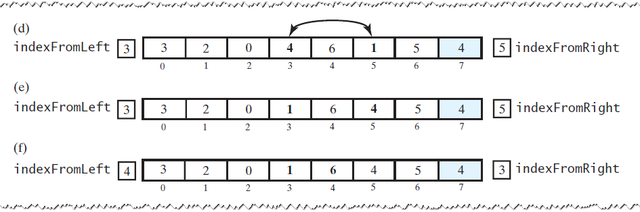
Creating the Partition
FIGURE 9-6 A partitioning strategy for quick sort
© 2015 Pearson Education, Inc., Upper Saddle River, NJ. All rights reserved.

Slide 20
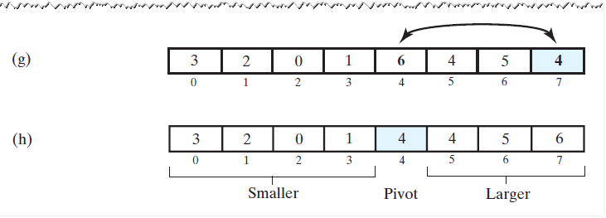
Creating the Partition
FIGURE 9-6 A partitioning strategy for quick sort
© 2015 Pearson Education, Inc., Upper Saddle River, NJ. All rights reserved.

Slide 21
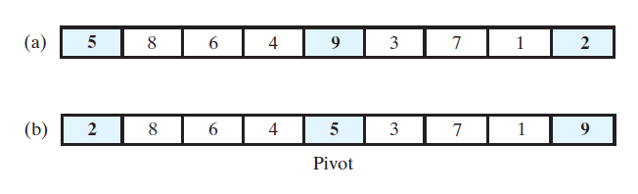
Creating the Partition
FIGURE 9-7 Median-of-three pivot selection: (a) The original array; (b) the array with its first, middle, and last entries sorted
© 2015 Pearson Education, Inc., Upper Saddle River, NJ. All rights reserved.

Slide 22
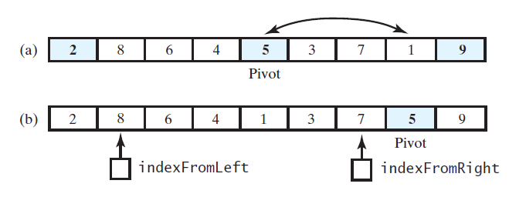
Adjusting the Partition Algorithm
FIGURE 9-8 (a) The array with its first, middle, and last entries sorted; (b) the array after positioning the pivot and just before partitioning
© 2015 Pearson Education, Inc., Upper Saddle River, NJ. All rights reserved.

Slide 23
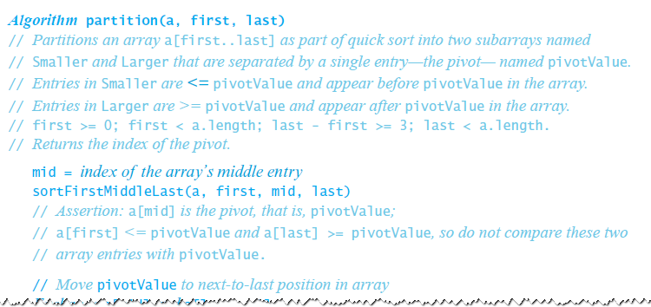
Adjusting the Partition Algorithm
© 2015 Pearson Education, Inc., Upper Saddle River, NJ. All rights reserved.

Slide 24
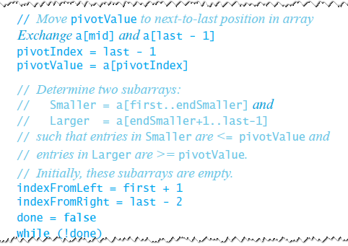
Adjusting the Partition Algorithm
© 2015 Pearson Education, Inc., Upper Saddle River, NJ. All rights reserved.

Slide 25
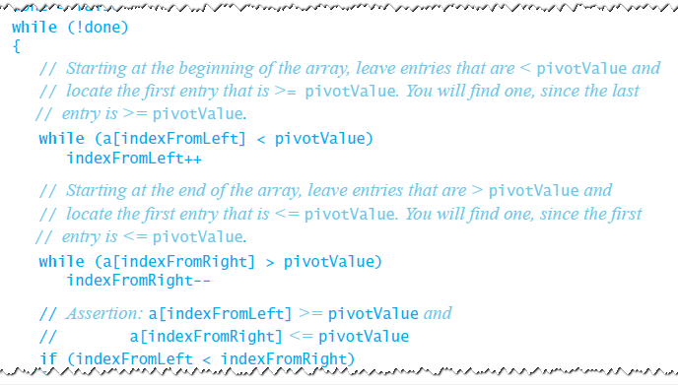
Adjusting the Partition Algorithm
© 2015 Pearson Education, Inc., Upper Saddle River, NJ. All rights reserved.

Slide 26
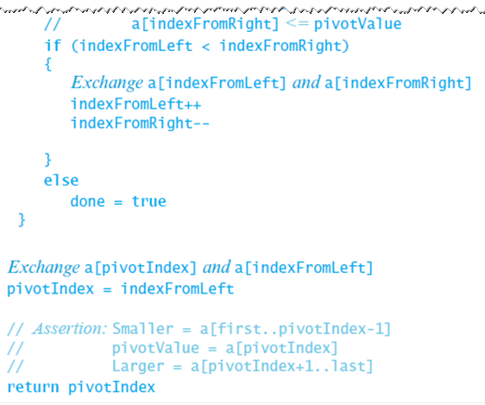
Adjusting the Partition Algorithm
© 2015 Pearson Education, Inc., Upper Saddle River, NJ. All rights reserved.

Slide 27
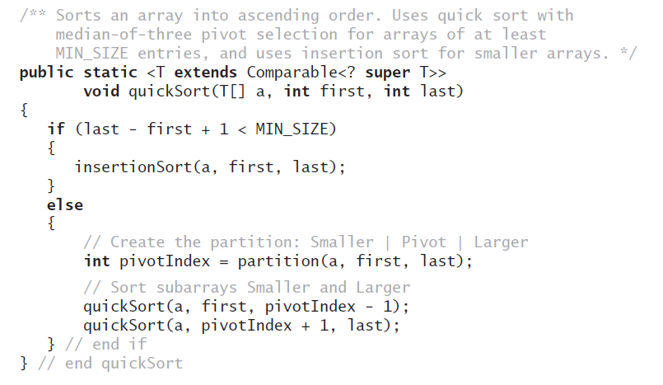
The Quick Sort Method
Above method implements quick sort.
© 2015 Pearson Education, Inc., Upper Saddle River, NJ. All rights reserved.

Slide 28
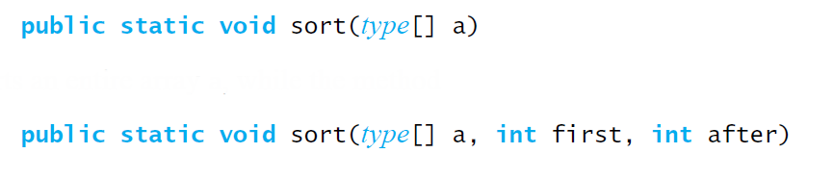
Quick Sort in the Java Class Library
Class Arrays in the package java.util uses a quick sort to sort arrays of primitive types into ascending order
© 2015 Pearson Education, Inc., Upper Saddle River, NJ. All rights reserved.

Slide 29
Radix Sort
Does not use comparison
Treats array entries as if they were strings that have the same length.
  Group integers according to their rightmost character (digit) into “buckets”
  Repeat with next character (digit), etc.
© 2015 Pearson Education, Inc., Upper Saddle River, NJ. All rights reserved.

Slide 30
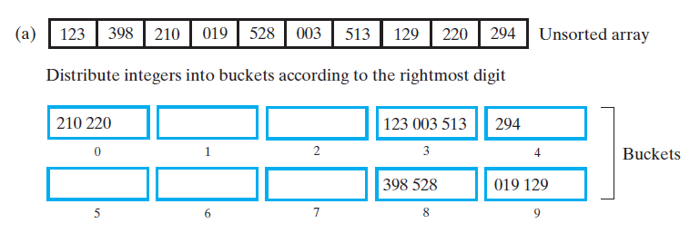
Radix Sort
FIGURE 9-9 Radix sort: (a) Original array and buckets after first distribution;
© 2015 Pearson Education, Inc., Upper Saddle River, NJ. All rights reserved.

Slide 31
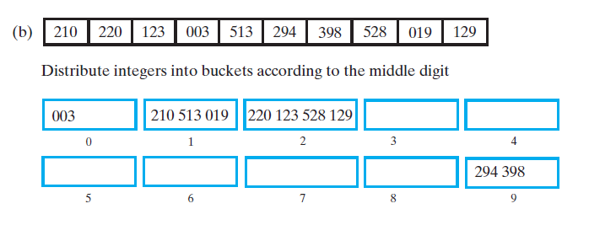
Radix Sort
FIGURE 9-9 Radix sort: (b) reordered array and buckets after second distribution;
© 2015 Pearson Education, Inc., Upper Saddle River, NJ. All rights reserved.

Slide 32
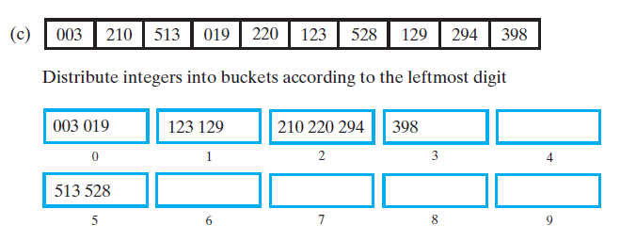

Radix Sort
FIGURE 9-9 Radix sort: (c) reordered array and
buckets after third distribution; (d) sorted array
© 2015 Pearson Education, Inc., Upper Saddle River, NJ. All rights reserved.

Slide 33
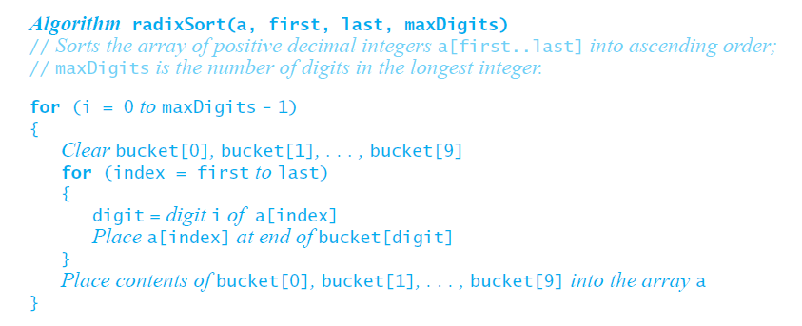
Pseudocode for Radix Sort
Radix sort is an O(n) algorithm for certain data,
it is not appropriate for all data
© 2015 Pearson Education, Inc., Upper Saddle River, NJ. All rights reserved.

Slide 34
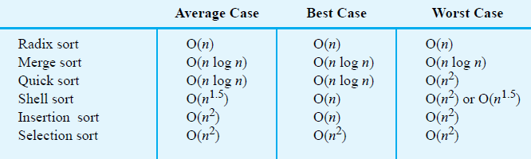
Comparing the Algorithms
FIGURE 9-10 The time efficiency of various sorting algorithms, expressed in Big Oh notation
© 2015 Pearson Education, Inc., Upper Saddle River, NJ. All rights reserved.

Slide 35
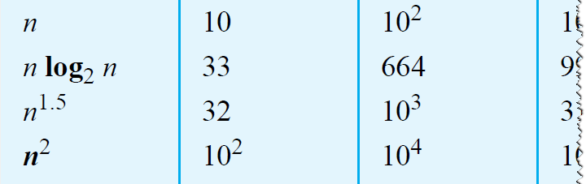
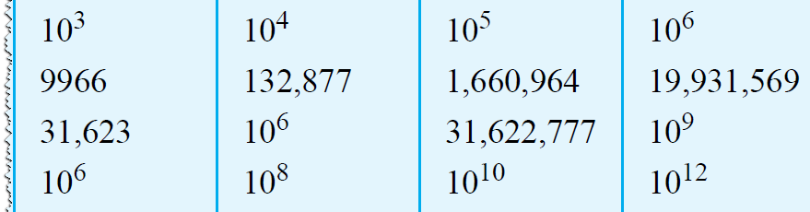
Comparing the Algorithms
FIGURE 9-11 A comparison of growth-rate
functions as n increases
© 2015 Pearson Education, Inc., Upper Saddle River, NJ. All rights reserved.

Slide 36
End
Chapter 9
© 2015 Pearson Education, Inc., Upper Saddle River, NJ. All rights reserved.

